Slide 1
Bertalanffy amid the seven schools: multiple traditions within systems thinking
Magnus Ramage
Society & Information Research Group,
Communication & Systems Department,
The Open University, UK

Slide 2
Multiple traditions of systems
‘Systems thinking’ is often presented as a unitary field, or definitively arising from one source or another
Followers of one approach sometimes fail to recognise that other approaches exist
Yet systems thinking exists in multiple traditions, both historically and currently
Aim of this talk is to explore some of those traditions, and to look at how Bertalanffy’s work related to them

Slide 3
Systems Thinkers
Study of lives and work of 30 thinkers, with extracts from their writings; book published in 2009 by Springer;
co-authored with Karen Shipp
  ‘only’ 30 thinkers means we left out many authors that some people might treasure
  all published in English (or translated) and explicitly identified themselves with systems in some way
Thinkers in book from biology, management, physiology, anthropology, chemistry, public policy, sociology and environmental studies

Slide 4
About the ‘schools’
Not coherent groupings gathered around a philosophical tradition; rather a loose group of people who knew each other or were influenced by each other
Noticeable coherence of ideas between members of a ‘school’ and distinction from other schools
Some blurring – could have put various thinkers in more than one school
Not historical eras (mostly) – rather grouped chronologically within the school

Slide 5
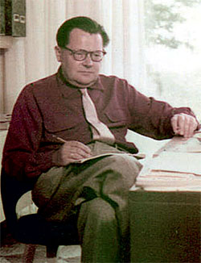
Early cybernetics
Soft & critical systems
Complexity theory
General systems theory
Learning systems
System dynamics
Later cybernetics

Slide 6
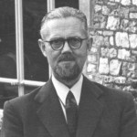
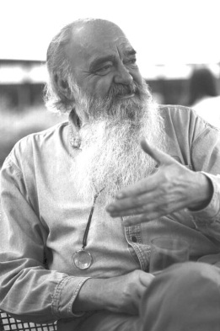
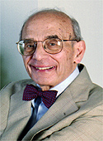
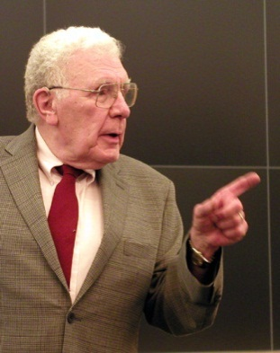
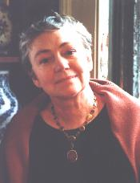
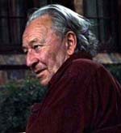
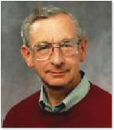
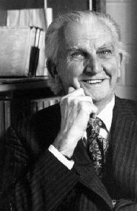
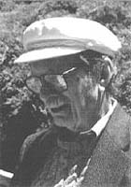
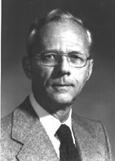
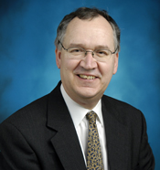
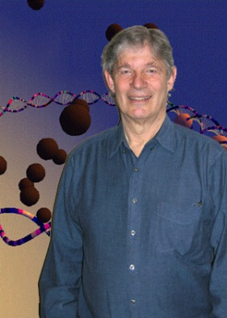
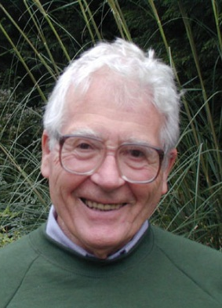
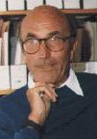
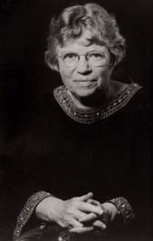
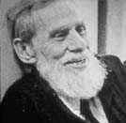
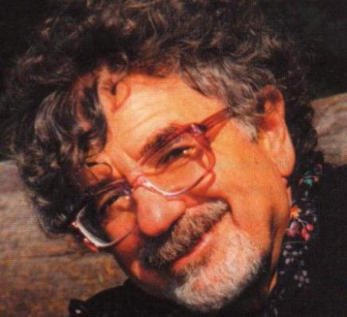
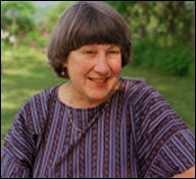
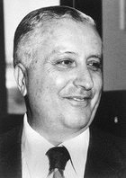
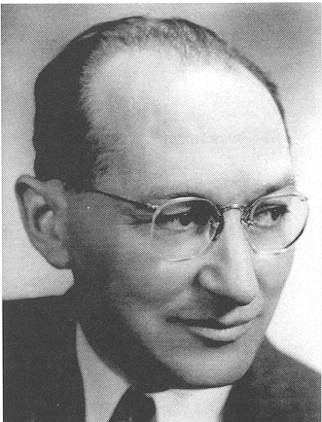
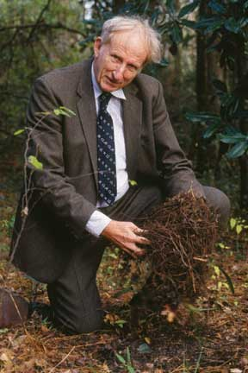
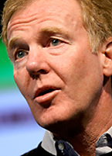
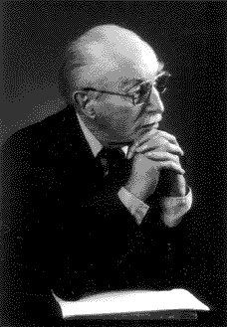
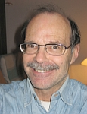
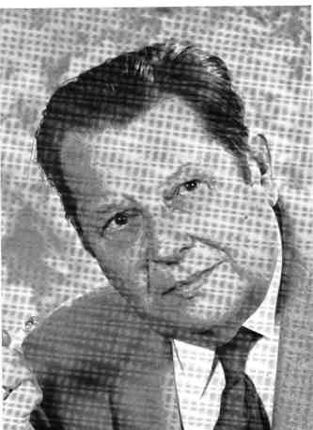

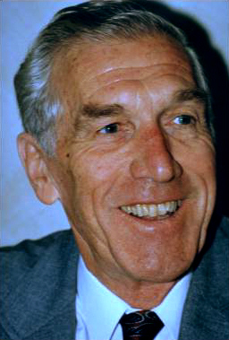
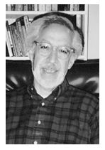
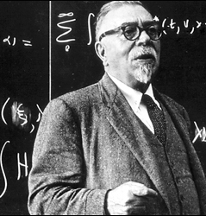

Slide 7
General Systems Theory
General characteristics of systems, with a focus on emergence, boundary, hierarchy, and the system in relation to its environment
Thinkers in book: Ludwig von Bertalanffy, Kenneth Boulding, Geoffrey Vickers, Howard Odum
Society for General Systems Research (now ISSS)
Bertalanffy’s work earlier than Wiener’s, and GST concepts became dominant, but SGSR formed later
Motto: ‘science in the service of humanity’

Slide 8
Bertalanffy’s contribution to GST
Giving it a name (n.b. a general theory of systems, not a theory of general systems, Pouvreau & Drack 2007)
  GST’s “subject matter is the formulation and derivation of those principles which are valid for ‘systems’ in general” (Bertalanffy 1955)
Founding the SGSR with Boulding, Rappaport etc
Built on organismic biology & thermodynamics
Key concepts of open system (inc. boundary & environment); dynamic equilibrium (Fliessgleichgewicht); organisation

Slide 9
Early Cybernetics
Exploring parallels between the behaviour of cognitive and engineered systems, with a focus on feedback and information
Thinkers in book: Norbert Wiener, Warren McCulloch, Gregory Bateson, Margaret Mead, W. Ross Ashby
Those who were present at Macy conferences
Not the same as first-order cybernetics, but related
Motto: ‘communication and control in the animal and the machine’

Slide 10
Bertalanffy and early cybernetics
Slightly antagonistic relationship
  Ashby viewed GST as empirical – it “takes the world as we find it, examines the various systems that occur in it … and then draws up statements about the regularities that have been observed to hold” (1958)
  Bertalanffy in turn disliked Ashby’s “definition of a system as a ‘machine with input’, because it only applied to closed systems” (Hammond 2003)
For Bertalanffy, there was a sharp distinction (Hammond 2003):
  cybernetics “reinforced equilibrium models of natural & social systems”
  GST was “explicitly evolutionary, emphasizing the importance of spontaneity and creativity”
  yet he also described a wider systems movement, headed by GST, which contained cybernetics as one of its components

Slide 11
Later Cybernetics
Applying cybernetics in management, biology, sociology and psychology; and the cybernetics of cybernetics
Thinkers in book: Heinz von Foerster, Stafford Beer, Humberto Maturana, Niklas Luhmann, Paul Watzlawick
Slightly later historically than ‘early cybernetics’
Not identical with second-order cybernetics (as not all these thinkers identify with that term), but strongly interested in reflexivity and the role of the observer

Slide 12
Bertalanffy and later cybernetics
Von Foerster denied all categories applied to himself, except that he was Viennese
  like Bertalanffy his ideas were shaped by the Vienna Circle, but they both rejected the Circle’s reductionism & positivism
Parallels between 2nd order cybernetics and:
  Bertalanffy's perspectivist theory of knowledge
  his view that perception is the interaction between the knower & the known
Luhmann (1997) drew on Bertalanffy for his view that a system “maintains itself by a difference … from the environment”, though he had a different view of the relationship between system & environment

Slide 13
System Dynamics
Revealing the underlying dynamics of organisational, societal and global systems through computer modelling
Thinkers in book: Jay Forrester, Donella Meadows, Peter Senge
Close to cybernetics in its focus on feedback, but arose quite separately, and for a long time was isolated from other systems approaches

Slide 14
Bertalanffy and system dynamics
Developed in the same milieu as cybernetics (at MIT, building on electrical engineering); initially Forrester took OR as inspiration – but he separated himself from both
“Although system dynamics separated itself from [GST], it repeatedly flirted with its concepts” (Lane 1994)
  Forrester (1968) describes SD as “a view of the nature of structure in purposeful systems” and “a general systems theory to serve as a unifying framework capable of organizing behavior and relationships in areas as diverse as engineering, medicine, management, psychology, & economics”
  the term ‘systems thinking’ has become used widely in SD circles to mean what Senge does – Wolstenholme (1999) suggested ‘qualitative system dynamics’ but this has not gained wide acceptance

Slide 15
Soft and Critical Systems
Methodologies for systemic intervention in organisations and government, addressing intractable problems, multiple perspectives and power
Thinkers in book: C. West Churchman, Russell Ackoff, Peter Checkland, Werner Ulrich, Michael Jackson
Largely arose as a reaction to systems analysis & operational research, by practitioners who found those approaches omitted key concerns
  shift to interpetivist philosophy

Slide 16
Bertalanffy & soft/critical systems
These thinkers derived their work from a critique of what Churchman called ‘the systems approach’ & Checkland ‘hard systems thinking’, which had merged GST language, systems analysis & OR
  their critique was close to Bertalanffy’s similar critiques of these approaches, but not clear they saw it like that!
Churchman and Ackoff gradually grew closer to GST over time (Churchman 1979 describes his book as a “theory of general systems”, distinct from Bertalanffy’s)
  Churchman, Ackoff, Checkland & Jackson were all presidents of ISSS

Slide 17
Complexity Theory
Modelling highly complicated and interconnected physical and human systems, focusing on self-organisation and emergence
Thinkers in book: Ilya Prigogine, Stuart Kauffman, James Lovelock
Arising largely from physical science, with an interest in social science but less so than some approaches
Santa Fé Institute important in this area, but not the sole originator – these three worked largely independently

Slide 18
Bertalanffy and complexity theory
Prigogine drew heavily on Bertalanffy’s work on dynamic equilibrium in his non-equilibrium thermodynamics
  as Capra (1996) observes, Prigogine’s key concept of dissipative structures, with its slightly paradoxical combination of terms, resembles Bertalanffy’s Fliessgleichgewicht
Kauffman doesn’t cite Bertalanffy, and was heavily influenced by McCulloch and Ashby; his approach appears reductionist & mechanistic, but he’s written strongly against reductionism
The guiding principle of complexity (in my view) is self-organisation, with which Bertalanffy had a varied relationship

Slide 19
Learning Systems
Systems of learning in individual practice, groups and organisations
Thinkers in book: Kurt Lewin, Eric Trist, Chris Argyris, Donald Schön, Mary Catherine Bateson
Focus on action research, group dynamics, individual and organisational learning
Broad group of thinkers influenced by Lewin – broadly psychological in various ways

Slide 20
Bertalanffy and learning systems
Lewin began his work in Gestalt psychology, where Koffka (1935) wrote (similar to Bertalanffy’s view): “… the whole is something else than the sum of its parts, because summing up is a meaningless procedure, whereas the whole-part relationship is meaningful”
Eric Trist was highly influenced by Bertalanffy’s theory of open systems in developing the concept (with Emery) of sociotechnical systems
Not aware of direct influence of Bertalanffy on Argyris or Schön – but I suspect it might exist on the latter

Slide 21
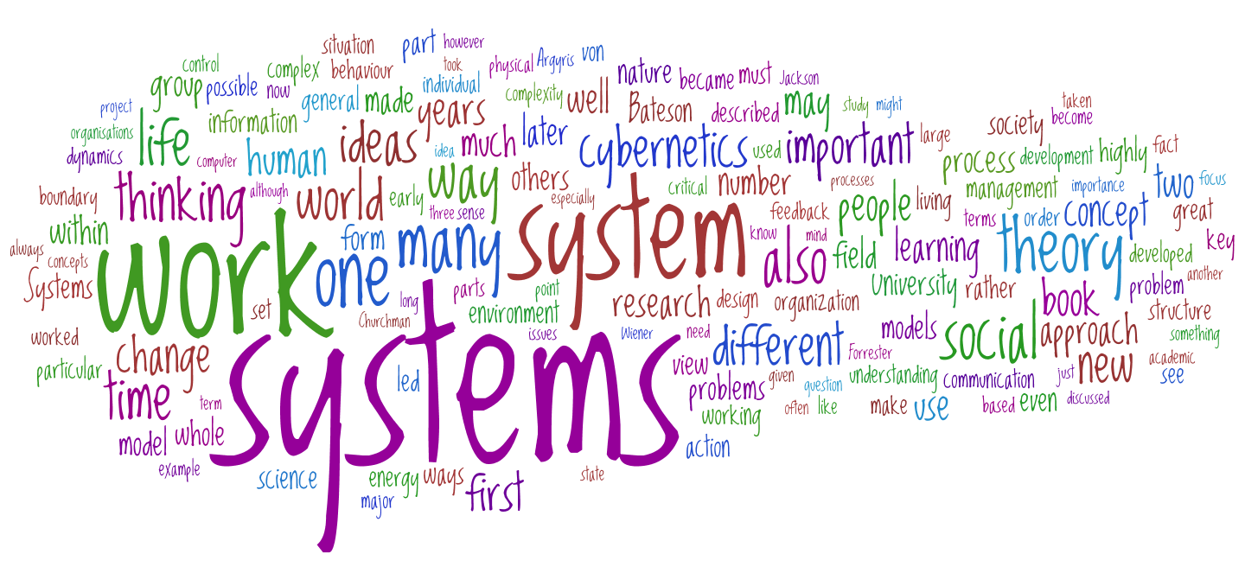
Systems Thinkers word cloud
Image created with http://www.wordle.net/

Slide 22
Contact details
Magnus Ramage,
Society & Information Research Group,
Communication & Systems Department,
The Open University, UK
m.ramage@open.ac.uk
http://www.cands.org/Home/people/magnus-ramage-1
Twitter: @magnusramage

