Slide 1
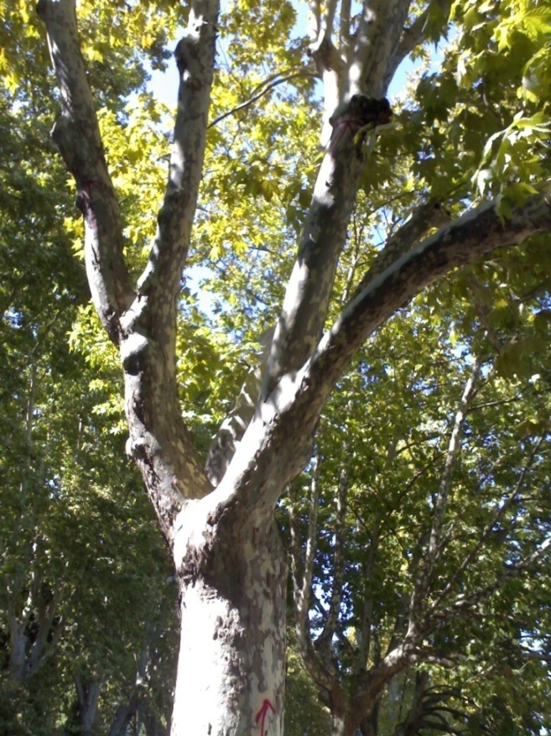
The Contribution
of the Russian Scientific Schools
to the Development of Systems Thinking
Helena Knyazeva,
Institute of Philosophy, Russian Academy of Sciences, Moscow

Slide 2
Presentation plan
General relations to L. von Bertalanffy
Russian scholars contributed to systems thinking
Main ideas of A. Bogdanov, V. Arnold and Sergei Kurdyumov
Some reflections on complex evolutionary thinking

Slide 3
1. Comparative analysis
L. von Bertalanffy
- systems are everywhere!
principle of equifinality, purposive behavior, goal-seeking,
- steady state (Fliessgleichgewicht)
Russian Schools
intedisciplinarity or transdisciplinarity
structures-attractors of evolution,
meta-stability, stability through instability, complex dynamics of regimes

Slide 4
2. The Russian Schools
Alexander Bogdanov (1873-1928) – Tectology as a universal science of organization;
Leonid Mandelstam (1879-1944) and Alexander Andronov (1901-1952) – theory of non-linear oscillations (self-exciting oscillations);
Vladimir Arnold (1937-2010) – systems theory, theory of catastrophes;

Slide 5
Russian schools
Nikita Moiseev (1917-2000) – universal evolutionism and co-evolution of man and nature;
Yurij Klimontovich (1924-2002) – physics of open non-equilibrium systems and theory of dynamic chaos;
Alexander Rudenko (1925-2004) – theory of open auto-catalytic systems in chemistry;
Sergei P. Kurdyumov (1928-2004) –synergetics as a theory of blow-up regimes

Slide 6
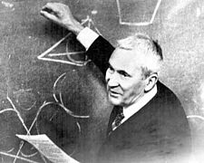
Andrey Kolmogorov (1903-1987)
Kolmogorov’s complexity
Descriptive definition of complexity

Slide 7
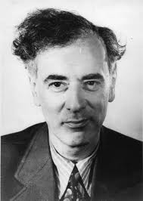
Lev D. Landau (1908-1968)
Concept of order parameters
Suitable macrovariables characterizing this change of global order are denoted as ‘order parameters’

Slide 8
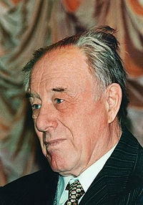
Nikita N. Moiseev (1917-2000)
universal evolutionism
co-evolution of man and nature

Slide 9
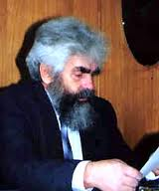
Yurij L. Klimontovich (1924-2002)
Dynamic chaos
Fine structure of chaos (e.g. turbulent flows)

Slide 10
The Russian image of complex systems theory as a worldview
Evolution
Global evolution
        Theory of cosmic evolution
        Synthetic theory of biological evolution
        Theory of evolution of complex system
Co-evolution

Slide 11
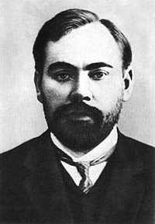
Alexander A. Bogdanov (Malinovsky) – 1873-1928
“Tectology” (Greek: τεκτονικός – builder, woodworker) as a universal science of organization.
Founder of the first institute of blood transfusion

Slide 12

A.A. Bogdanov “Tectology”
First Russian edition -1913
German edition – 1922
Third Russian edition 1925-1929.
1980, English translation as Essays in Tektology: The General Science of Organization, trans. George Gorelik, Seaside, CA, Intersystems Publications, 1980

Slide 13
Main ideas and concepts of tectology
Universalism of organizational approach: “Any human activity is objectively organizational or disorganizational”;
Objective appropriateness (reasonability);
bi-regulator as a kind of feedback;

Slide 14
Main ideas and concepts of tectology
Holism: concept of conjugation as a way of connection of different elements; conjugation is collaboration, any communication, assimilation, etc.
Consequences:
1) disorganized whole is less than a sum of parts
2) organized whole is more than a sum of parts (synergy effect!)

Slide 15
Main ideas and concepts of tectology
ingression (entry of an element into a system) – e.g. conciliation of enemies;
homeostasis as a mobile equilibrium;
increase of diversity of elements as a way of struggle with aging;
law of relative resistances: structural stability of a whole is determined by its partial stability;
crisis as an equilibrium breaking and a transition to a new equilibrium.

Slide 16
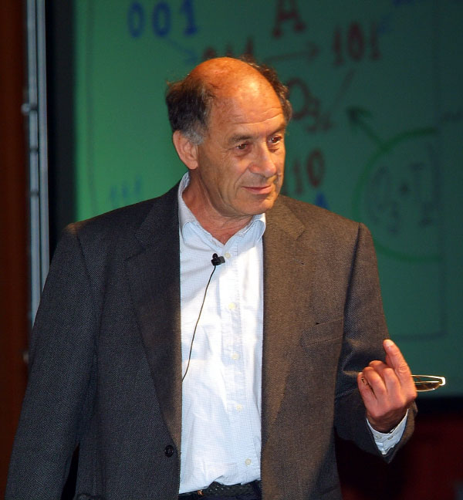
Vladimir I. Arnold (1937-2010)
Mathematical theory of catastrophes

Slide 17
KAM-Theorem
According to KAM-Theorem of A.N. Kolmogorov (1954), V.I. Arnold (1963), and J. K. Moser (1967), trajectories in the phase space of classical mechanics are neither completely regular, nor completely irregular, but depend sensitively on the chosen initial conditions.
limits of long-term predictions. This is known as the ‘butterfly effect’: initial, small and local causes soon lead to unpredictable, large and global effects.

Slide 18
Complexity, according to Arnold
Optimization of parameters of a plan can lead to complete destruction of a planned system owing to emerging instability;
Multistage management (n > 3) is unstable; two-stage management leads to oscillations; genuine stability can be provided by a single-stage management.

Slide 19
Models of complex structures transformation (Arnold)
Gradual movement to a better state immediately leads to worsening;
In the course of movement from worse state to a better state, the resistance of a system to any change increases;
Maximum of resistance can be reached earlier than the worst state;

Slide 20
Models of complex structures transformation (Arnold)
4. When the worst state is passed the systems begins to be attracted to the best state;
5. If a system is managed to be transformed at once, stepwise from a bad stable state to a state which is relatively near to a desired good state, it will evolve by itself towards this good state.

Slide 21
Theory of Complexity as a Worldview
Self-organization
Evolution and co-evolution
Complexity
Non-linearity
Emergence
Creative chaos

Slide 22
Evolutionary thinking
Non-linear thinking
Holistic thinking
Complex thinking

Slide 23
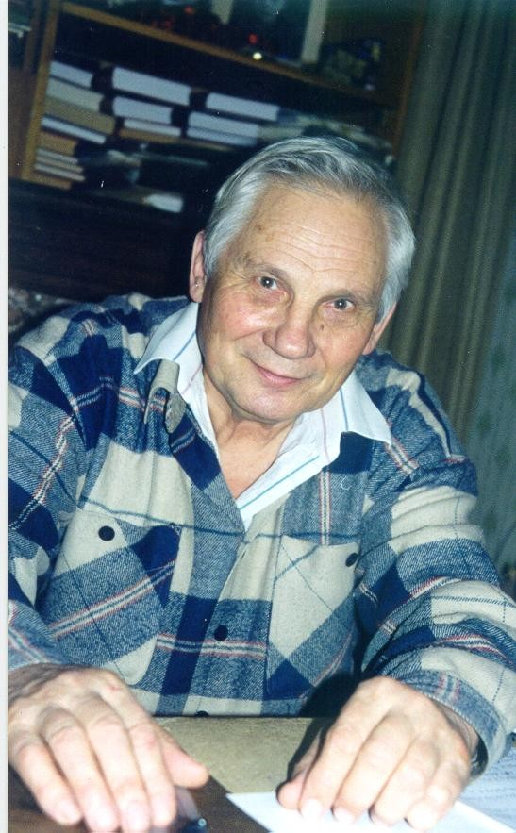
Non-linearity as switching of different evolutionary regimes
Theory of complexity as a theory of non-
stationary dissipative
structures
that develop in
blow-up
regimes
Sergei P. Kurdyumov
(1928 – 2004)

Slide 24
Types of blow-up regimes in open non-linear dissipative media

Slide 25
Examples of eigenfuctions of nonlinear dissipative media and their projections

Slide 26
Self-organization
Spontaneous formation of new structures
Inner forces (without any external influences)
Role of small perturbations (fluctuations, chaos): Small is beautiful!

Slide 27
Idea of co-evolution (joint self-consistent development of different structures)
Tempo-worlds
Dynamics of changes of systems’ time and space, acceleration of course of time, nested cycles of evolution
Space parameters for emergence of complexity
Topology of organization
Rightly organized in space (resonant) influences

Slide 28
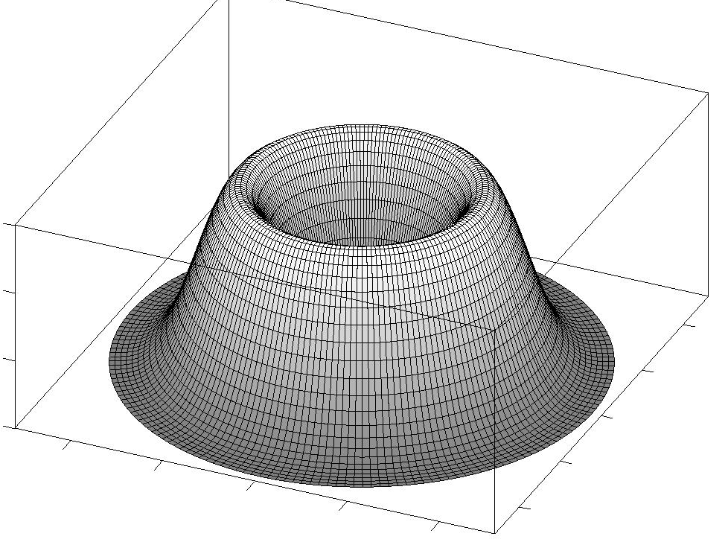
Architecture of three-dimensional eigenfunctions (structure-attractors)

Slide 29
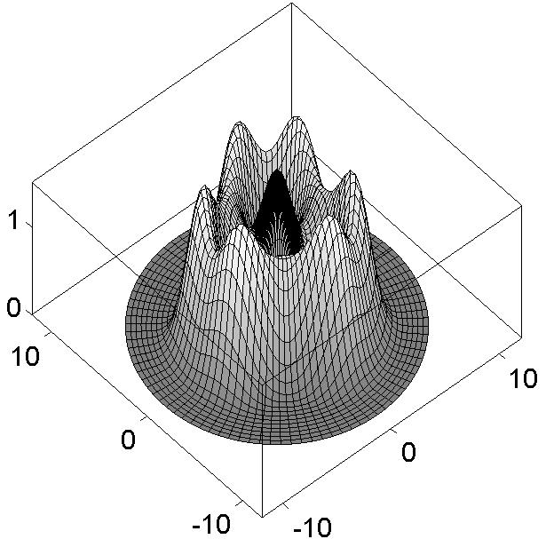
Architecture of three-dimensional eigenfunctions (structure-attractors)

Slide 30
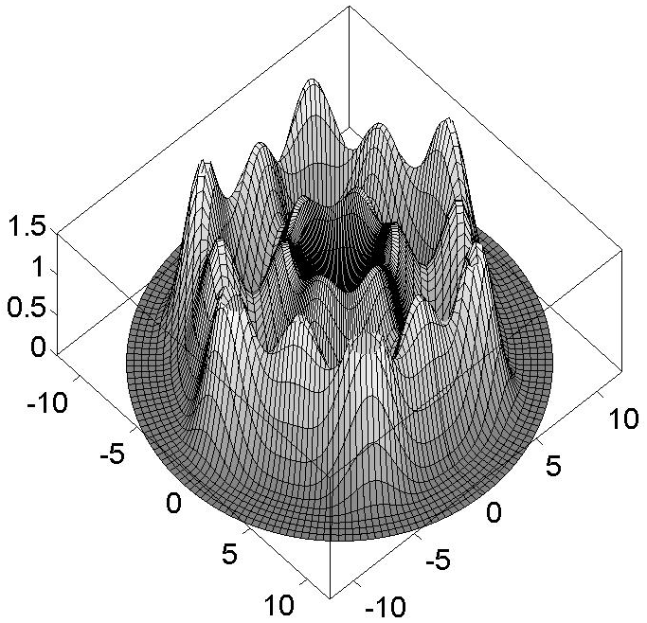
Architecture of three-dimensional eigenfunctions (structure-attractors)

Slide 31
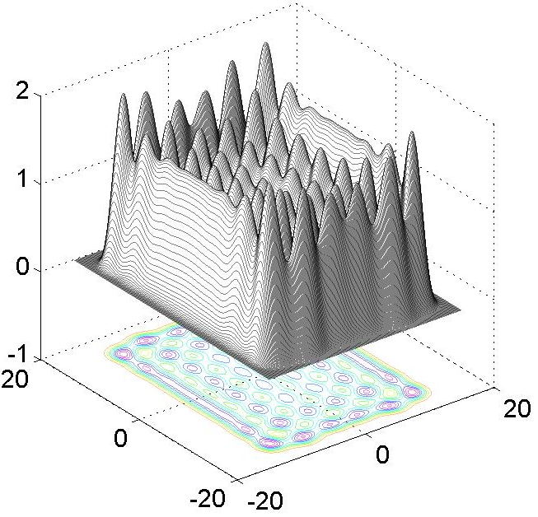
Architecture of three-dimensional eigenfunctions (structure-attractors)

Slide 32
Some peculiarities of the Moscow school of synergetics
localization in the form of structures;
complex spectra of structures-attractors;
different types of blow-up regimes;
co-evolution, joint and consistent development of complex structures;
the connection between space and time;
ways of non-linear soft management

Slide 33
Non-linear thinking
irreversibility (arrow of time)
points of bifurcations
change of tempo (regime) of evolution
small deviations, fluctuations, chances
thresholds of sensitivity
dead ends of evolution (stages of involution)
influence of the future
nested evolution

Slide 34
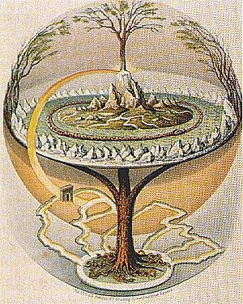
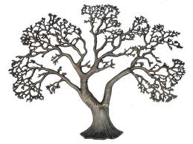
Tree of evolution
(world tree, tree of life)

Slide 35
Holistic thinking
Emergent properties
    the whole is more than a sum of parts
    a part has emergent properties as well
Synergy
Cooperative effects (coherence)

Slide 36
Holism
holistic science
holistic education
holistic therapies (health)
holistic management

Slide 37
Emergence
unpredictability, incomprehensibility (epistemological aspect of novelty)
spontaneity: creative chance is rooted in nature
irreducibility of properties of the whole to parts (elements)
Irredusibility of more organized to less organized, complexity to simplicity
quatitative jump, phase transition, radical transformation

Slide 38
Emergent nature
Emergence is way of birth of
novelty
in the process of evolution

Slide 39
Complex thinking
Complex thinking which is correspondent to complexity of the world
Thinking in complexity (K. Mainzer)
Complex cognition
    Interaction of different mental activities (perception, memory, reasoning, emotions, etc.)
    Complexity of a situation an agent is confronted with (thinking, decision making, problem solving)

Slide 40
Complexity of systems
Their functions are much more complex than they are
Number of elements and complexity of relations
Variety of elements
Multilevel structure
Openness
Emergent properties
Memory, hysteresis
Loops of feedback

Slide 41
Complexity - instability
The more complex a system is, the more unstable it is.
Stability trough instability. A system exercises in its instability
Two types of instability

Slide 42
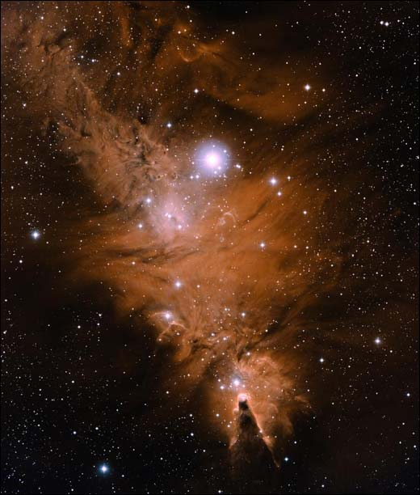
Chaos
Chaos as a creative principle
Self-organization at the edge of chaos

Slide 43
Chaos
Chaos as a way of going out to a trend of self-organization
Chaos as a way of synchronization of tempos of subsystems
Poising at the edge of chaos as a way of maintenance of complex organization (self-organized criticality);
Chaos as a factor of adaptation to changeable conditions of environment;
Transition from chaos to order and vice versa as a way of birth of beauty;
A part of inner chaos as a necessary supplement to external control is a way of self-goverment of a complex system;
Disorder and variety of elements as a basis for attainment of their unity and organization;
Chaos as a stimulus, push of evolution;
Chaos as a way of renewal of a complex organization, as a way to an innovation.

Slide 44
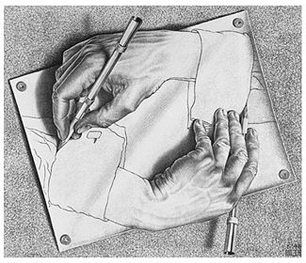
Cognitive complexity
Cognitive structures are emergent
Reciprocal determination of the I and the other
Cognitive systems are dynamical and self-organizing

Slide 45
Publications (with S.P. Kurdyumov):
(2001) Nonlinear Synthesis and Co-evolution of Complex Systems. In: World Futures 57: pp. 239--261.
(2002) Foundations of Synergetics: Blow-up Regimes, Self-organization, Tempoworlds. St.Petersburg: Aletheia Publishers. 414 p. (in Russian).
(2007) Synergetics: Non-linearity of Time and Landscapes of Coevolution. KomKniga, Moscow (in Russian).

Slide 46
Publications
(1998) The Synergetic View of Human Creativity // Evolution and Cognition. Vienna, 1998. Vol.4, N 2. P.145-155.
(2003) Knyazeva H. Self-Reflective Synergetics. In: Systems Research and Behavioral Science. Vol. 20. N 1. P.53-64.
(2005) Knyazeva H. Figures of Time in Evolution of Complex Systems. In: Journal for General Philosophy of Science. Vol.36. N 2. P.289-304.
(2009) Knyazeva H. Nonlinear Cobweb of Cognition. In: Foundations of Science. Vol. 14, N 3. P.167-179.

Slide 47
My sites and email
http://spkurdyumov.narod.ru
http://iph.ras.ru/knyazeva.htm
knyazeva@iph.ras.ru
helena_knyazeva@mail.ru

